Slide 1
PLADIATOR
Plant Disease Detector

Slide 2
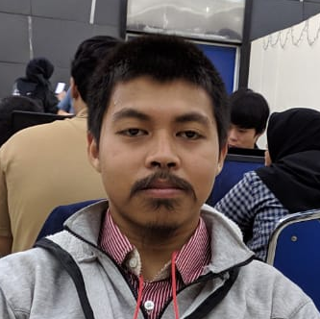
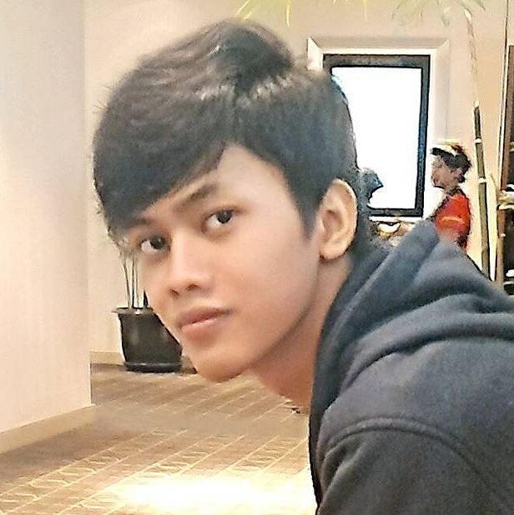
MEET THE TEAM
Find The Certainess
Mokahmad Wijaya
Reza Aditya S. M.
Deep Learning Engineer
Front-End Developer

Slide 3
Pladiator
Our
Algorithm
Kami menggunakan algortma Convolutional Neural Network untuk mengenali gambar daun dan mengklasifikasikannya menjadi beberapa penyakit sesuai dengan dataset yang ada.
Arsitektur/Model yang digukana adalah Inception-v3 yang ditambahi dengan beberapa layer (Flatten, Dense, Dropout, dan Dense). Deep Learning Library yang kami gunakan adalah Tensorflow

Slide 4
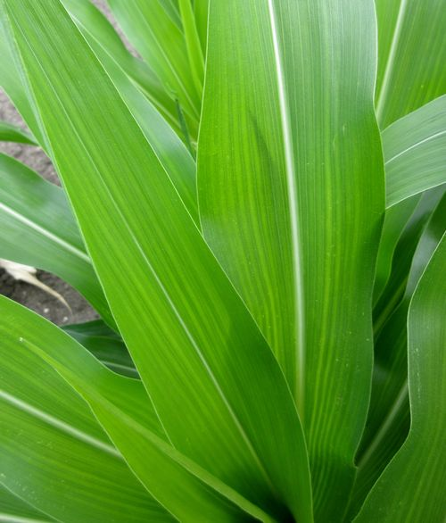
Pladiator
Preprocessing
[[[34, 64, 89], ...]
.....
.....
.....
[[12, 104, 234], ...]]]
[[[0.12, 0.24, 0.36], ...]
.....
.....
.....
[[0.04, 0.43, 0.94], ...]]]
Sebelum melakukan inference, gambar baik untuk training maupun inference akan melalui proses konversi ke array, resize dan normalization. Resize akan mengubah ukuran gambar dengan resolusi apapun menjadi 299x299. Konversi ke array merubah gambar menjadi array dengan dimensi [lebar, tinggi, channel] (dalam kasus kami [jumlah, lebar, tinggi, channel]). Kemudian normalization akan mengubah range tiap channel (RGB) dari 0-255 menjadi 0-1.

Slide 5
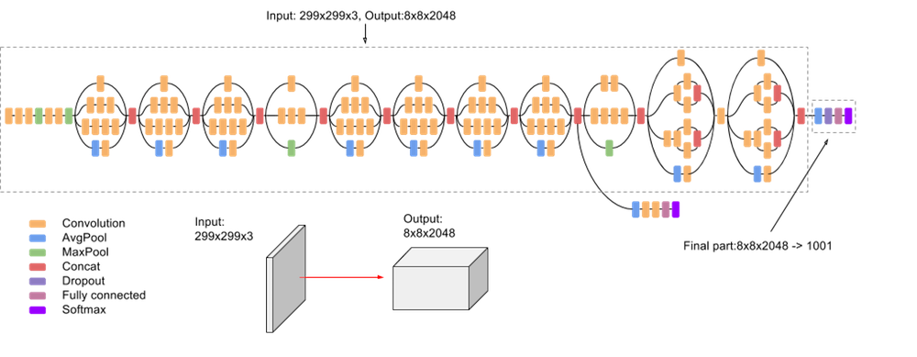
Pladiator
Arsitektur Inception-v3

Slide 6
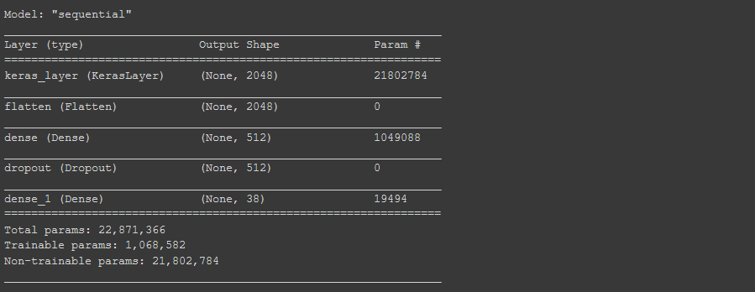
Pladiator
Arsitektur Tambahan
Keras_layer merupakan perwakilan dari Inception-v3 dan layer selain itu merupakan
Layer tambahan untuk menghasilkan array yang akan digunakan untuk proses
Klasifikasi. (Screenshoot hasil kerja kami dan training dilakukan selama +- 4 jam)

Slide 7
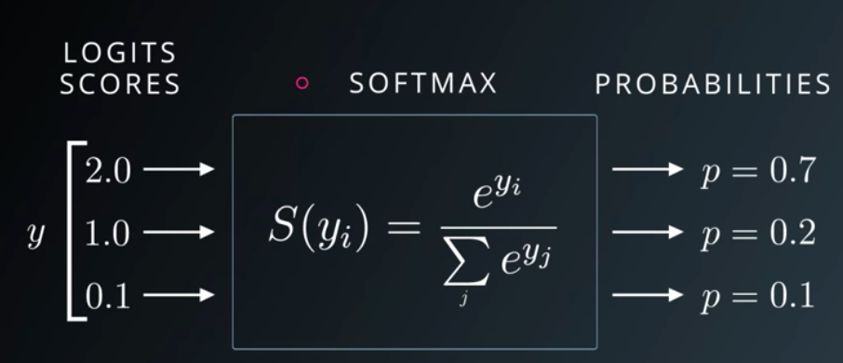
Pladiator
Classification
[2,
3,
1,
16,
...,
...,
...,
5,
4,
7]
[0.04,
0.09,
0.01,
0.44,
...,
...,
...,
0.13,
0.14,
0.20]
[Berri Sehat,
Apel Sehat,
Ceri sehat,
Jagung sehat,
...,
...,
...,
J. bercak Cercospora,
J. oksidasi biasa,
Jagung hawar]
Pada layer terakhir, terdapat hidden layer dengan activation function berupa softmax yang biasa digunakan sebagai layer untuk klasifikasi dengan panjang array sesuai jumlah kelas saat melakukan training (dalam kasus ini ada 38 kelas).

Slide 8
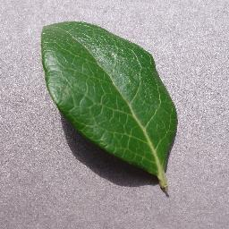
Pladiator
Preprocessing
Resize = 299x299
Ubah ke Array
[[[199 192 199], [208 201 208], [219 212 219], ... [214 207 212], [217 210 215], [212 205 210]],
[[204 197 204], [206 199 206], [213 206 213], ... [212 205 210], [213 206 211], [211 204 209]],
[[207 200 207], [202 195 202], [204 197 204], ... [204 197 202], [205 198 203], [213 206 211]],
...
[[151 144 157], [138 131 144], [143 136 148], ... [165 157 168], [166 157 168], [170 162 173]],
[[142 135 148], [144 137 150], [136 129 142], ... [161 153 164], [162 154 165], [165 157 168]],
[[154 147 160], [148 141 154], [152 145 158], ... [164 156 167], [167 159 170], [171 163 174]]]

Slide 9
Pladiator
Ubah ke Array
Preprocessing
[[[199 192 199], [208 201 208], [219 212 219], ... [214 207 212], [217 210 215], [212 205 210]],
[[204 197 204], [206 199 206], [213 206 213], ... [212 205 210], [213 206 211], [211 204 209]],
[[207 200 207], [202 195 202], [204 197 204], ... [204 197 202], [205 198 203], [213 206 211]],
...
[[151 144 157], [138 131 144], [143 136 148], ... [165 157 168], [166 157 168], [170 162 173]],
[[142 135 148], [144 137 150], [136 129 142], ... [161 153 164], [162 154 165], [165 157 168]],
[[154 147 160], [148 141 154], [152 145 158], ... [164 156 167], [167 159 170], [171 163 174]]]
Normalisasi Array (array / 255)
[[[0.78039216 0.75294118 0.78039216], [0.81568627 0.78823529 0.81568627], [0.85882353 0.83137255 0.85882353], ... [0.83921569 0.81176471 0.83137255], [0.85098039 0.82352941 0.84313725], [0.83137255 0.80392157 0.82352941]],
[[0.8 0.77254902 0.8 ], [0.80784314 0.78039216 0.80784314], [0.83529412 0.80784314 0.83529412], ... [0.83137255 0.80392157 0.82352941], [0.83529412 0.80784314 0.82745098], [0.82745098 0.8 0.81960784]],
[[0.81176471 0.78431373 0.81176471], [0.79215686 0.76470588 0.79215686], [0.8 0.77254902 0.8 ], ... [0.8 0.77254902 0.79215686], [0.80392157 0.77647059 0.79607843], [0.83529412 0.80784314 0.82745098]],
...
[[0.59215686 0.56470588 0.61568627], [0.54117647 0.51372549 0.56470588], [0.56078431 0.53333333 0.58039216], ... [0.64705882 0.61568627 0.65882353], [0.65098039 0.61568627 0.65882353], [0.66666667 0.63529412 0.67843137]],
[[0.55686275 0.52941176 0.58039216], [0.56470588 0.5372549 0.58823529], [0.53333333 0.50588235 0.55686275], ... [0.63137255 0.6 0.64313725], [0.63529412 0.60392157 0.64705882], [0.64705882 0.61568627 0.65882353]],
[[0.60392157 0.57647059 0.62745098], [0.58039216 0.55294118 0.60392157], [0.59607843 0.56862745 0.61960784], ... [0.64313725 0.61176471 0.65490196], [0.65490196 0.62352941 0.66666667], [0.67058824 0.63921569 0.68235294]]]

Slide 10
Pladiator
Ubah ke Array
Inference
Normalisasi Array
(array / 255)
[[[0.78039216 0.75294118 0.78039216], [0.81568627 0.78823529 0.81568627], [0.85882353 0.83137255 0.85882353], ... [0.83921569 0.81176471 0.83137255], [0.85098039 0.82352941 0.84313725], [0.83137255 0.80392157 0.82352941]],
[[0.8 0.77254902 0.8 ], [0.80784314 0.78039216 0.80784314], [0.83529412 0.80784314 0.83529412], ... [0.83137255 0.80392157 0.82352941], [0.83529412 0.80784314 0.82745098], [0.82745098 0.8 0.81960784]],
[[0.81176471 0.78431373 0.81176471], [0.79215686 0.76470588 0.79215686], [0.8 0.77254902 0.8 ], ... [0.8 0.77254902 0.79215686], [0.80392157 0.77647059 0.79607843], [0.83529412 0.80784314 0.82745098]],
...
[[0.59215686 0.56470588 0.61568627], [0.54117647 0.51372549 0.56470588], [0.56078431 0.53333333 0.58039216], ... [0.64705882 0.61568627 0.65882353], [0.65098039 0.61568627 0.65882353], [0.66666667 0.63529412 0.67843137]],
[[0.55686275 0.52941176 0.58039216], [0.56470588 0.5372549 0.58823529], [0.53333333 0.50588235 0.55686275], ... [0.63137255 0.6 0.64313725], [0.63529412 0.60392157 0.64705882], [0.64705882 0.61568627 0.65882353]],
[[0.60392157 0.57647059 0.62745098], [0.58039216 0.55294118 0.60392157], [0.59607843 0.56862745 0.61960784], ... [0.64313725 0.61176471 0.65490196], [0.65490196 0.62352941 0.66666667], [0.67058824 0.63921569 0.68235294]]]
Inference dengan model
[4.6510851e-07, 2.2118666e-08, 7.2860371e-09, 2.5625669e-03, 9.9740797e-01, 4.0713604e-07, 6.0860458e-07, 1.8846893e-11, 2.4848626e-12, 3.5132546e-11, 2.0301982e-09, 1.5751841e-09, 6.1362911e-12, 2.5331942e-13, 2.5936744e-12, 4.9445212e-08, 1.1052828e-09, 1.2400291e-10, 1.1722995e-10, 2.8861045e-09, 2.2245803e-12, 4.9718119e-07, 4.3223460e-07, 5.1047064e-09, 2.2830574e-05, 5.6818165e-11, 4.2907910e-11, 1.7561041e-07, 7.1636391e-10, 6.8038450e-09, 2.9787718e-06, 2.9060745e-08, 2.4517002e-09, 4.8934942e-07, 3.7937795e-08, 7.4077233e-09, 2.7334131e-11, 4.8361602e-07]

Slide 11
Pladiator
Ubah ke Array
Classification
Normalisasi Array
(array / 255)
Inference dengan
model
[4.6510851e-07, 2.2118666e-08, 7.2860371e-09, 2.5625669e-03, 9.9740797e-01, 4.0713604e-07, 6.0860458e-07, 1.8846893e-11, 2.4848626e-12, 3.5132546e-11, 2.0301982e-09, 1.5751841e-09, 6.1362911e-12, 2.5331942e-13, 2.5936744e-12, 4.9445212e-08, 1.1052828e-09, 1.2400291e-10, 1.1722995e-10, 2.8861045e-09, 2.2245803e-12, 4.9718119e-07, 4.3223460e-07, 5.1047064e-09, 2.2830574e-05, 5.6818165e-11, 4.2907910e-11, 1.7561041e-07, 7.1636391e-10, 6.8038450e-09, 2.9787718e-06, 2.9060745e-08, 2.4517002e-09, 4.8934942e-07, 3.7937795e-08, 7.4077233e-09, 2.7334131e-11, 4.8361602e-07]
['Apple___Apple_scab', 'Apple___Black_rot', 'Apple___Cedar_apple_rust', 'Apple___healthy', 'Blueberry___healthy', 'Cherry_(including_sour)___Powdery_mildew', 'Cherry_(including_sour)___healthy', 'Corn_(maize)___Cercospora_leaf_spot Gray_leaf_spot', 'Corn_(maize)___Common_rust_', 'Corn_(maize)___Northern_Leaf_Blight', 'Corn_(maize)___healthy', 'Grape___Black_rot', 'Grape___Esca_(Black_Measles)', 'Grape___Leaf_blight_(Isariopsis_Leaf_Spot)', 'Grape___healthy', 'Orange___Haunglongbing_(Citrus_greening)', 'Peach___Bacterial_spot', 'Peach___healthy', 'Pepper,_bell___Bacterial_spot', 'Pepper,_bell___healthy', 'Potato___Early_blight', 'Potato___Late_blight', 'Potato___healthy', 'Raspberry___healthy', 'Soybean___healthy', 'Squash___Powdery_mildew', 'Strawberry___Leaf_scorch', 'Strawberry___healthy', 'Tomato___Bacterial_spot', 'Tomato___Early_blight', 'Tomato___Late_blight', 'Tomato___Leaf_Mold', 'Tomato___Septoria_leaf_spot', 'Tomato___Spider_mites Two-spotted_spider_mite', 'Tomato___Target_Spot', 'Tomato___Tomato_Yellow_Leaf_Curl_Virus', 'Tomato___Tomato_mosaic_virus', 'Tomato___healthy']
Confidence dari
Model
Argmax (index
dari max value)
0.997408
4
Value pada index 4
Blueberry___healthy
class: Blueberry___healthy, confidence: 0.997408

Slide 12

Pladiator
Clone,
Star, and
Watch
Our Git!
github.com/Oskop
/Pladiator

Slide 13
THANKS FOR
WATCHING

